Slide 1
Photovoltaic Cells
Gabriel Laboy

Slide 2
Presentation overview
Defining Photovoltaic Cell
Brief History of the Photovoltaic Cell
Science Behind the Photovoltaic Cell
Limitations of the Photovoltaic Cell

Slide 3
The Photovoltaic Cell
Photovoltaic Definition
Relating to the production of electric current at the junction of two substances exposed to light [6]
Putting it together
Photovoltaic cell is any device that directly converts the energy of light into electricity through the photovoltaic effect [2]
Also known as a solar cell

Slide 4
Brief history
First uses of harnessing the sun’s power was to create fire
A lot of technologies would be made with solar power with the intent of heating things (food, heat engines, etc.)
1839 – French scientist Edmond Becquerel discovers the photoelectric effect
1954 – Daryl Chapin, Calvin Fuller, and Gerald Pearson make the first successful silicon cell in the US at Bell Labs which had a 4% conversion efficiency!

Slide 5
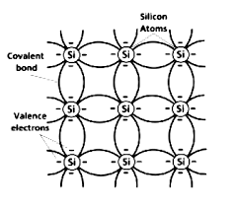
The science
Made with two semiconductors
Base material for both is typically silicon and mixed with another element to produce two layers
Silicon has four valence electrons in outer energy level
Will bond with other atoms of itself to stabilize and form a crystalline structure

Slide 6
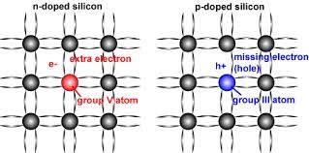
The science
Why Silicon?
When energy is added, some electrons break free of bonds and become free carriers and bond somewhere else
On its own is a poor conductor because of lack of free electrons (everything is bonded)
Doping – intentional adding of impurities to crystal lattice structure to modify its electrical properties

Slide 7
The science
p-type layer
Added element such as boron or gallium
Element has three valence electrons in outer energy level and cannot fully bond with the silicon
The effect creates positively charged “holes” which are looking for that missing electron

Slide 8
The science
n-type layer
Added element such as phosphorous
Element has five valence electrons in outer energy level which is one more than needed to bond with silicon
Can be considered “excess” of electrons which move around freely in semiconductor

Slide 9
The science
Construction
n-type and p-type layers sandwiched with each other
Creates an area called the depletion zone where the free electrons from the n-type move to the holes in the p-type layer
Once the depletion zone hits equilibrium, an electric field is created allowing easy flow of electrons from P to N, but not the other way around

Slide 10
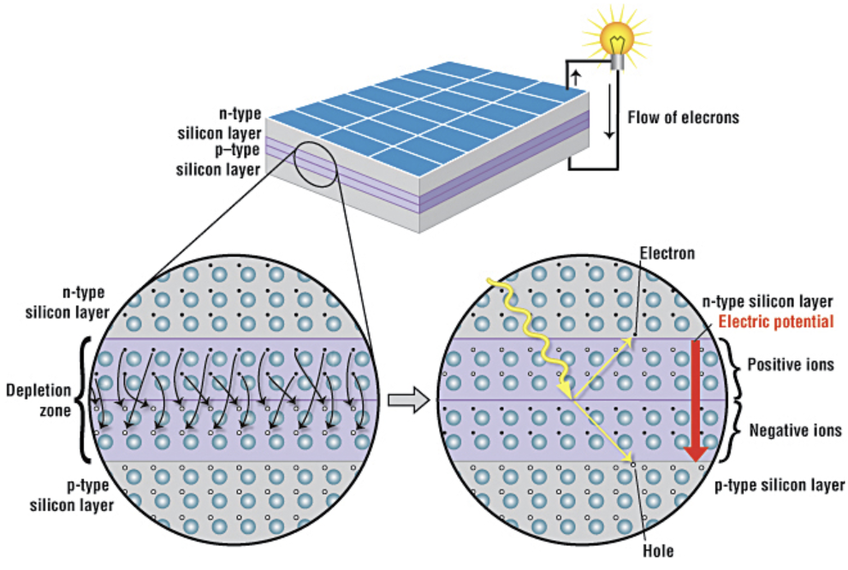

Slide 11
The science
What does sunlight do
The sun emits photons, which when it hits an electron in the p-layer of the cell, excites it and gives it enough energy to pass through the e-field back to the n-layer
This movement causes a disruption in the electrical neutrality, and will cause equivalent number of electrons to move back to the p-layer
By connecting the layers with an external path, the electrons have a way to move back to the p-layer, creating current

Slide 13
The science
The last steps
Silicon is a shiny metal with reflective properties, so anti-reflective coatings are added to improve absorption of photons
A glass cover plate is set over the cells to protect it from the environment

Slide 14
Limitations
Electromagnetic Spectrum
Light is separated into different wavelengths, where some photons have too little or too much energy to work with solar cells
The energy able to be absorbed is called band gap energy measured in electron volts (eV)
Band gap energy is dependent on material (average of 1.1 eV for crystalline silicon)
If band gap is too low, have low voltage output (optimal value is about 1.4 eV)

Slide 15
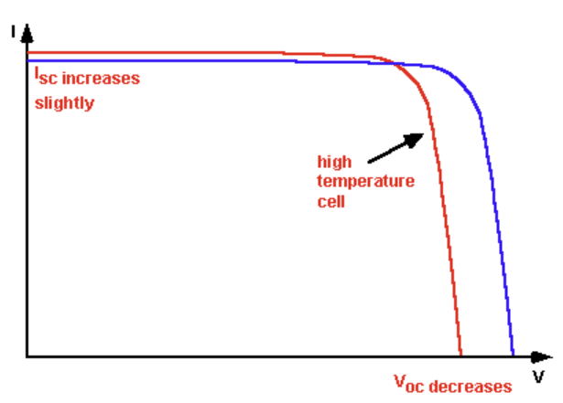
Limitations
Temperature
Increases in temperature actually causes a decrease in band gap energy
An increase in temperature causes an increase in the energy levels of the electrons -> leads to a lower bond energy needed to break the electron bond -> leads to a lower band gap energy
Reflected by a drop in voltage and increase in current

Slide 16
Limitations
Semiconductor
Not as effective as a metal for transporting current since it has a high internal (or series) resistance
To mitigate loss, a metal contact grid is added over cells to shorten distance electrons travel
Due to metal blocking photons, grid has to remain small

Slide 17
references
[1] Aldous, Scott et al. “How do Solar Panels Work?” HowStuffWorks, 14 Apr 2023. https://science.howstuffworks.com/environmental/energy/solar-cell.htm.
[2] Ashok, S. et al. “solar cell,” Britannica, 6 Apr 2023. https://www.britannica.com/technology/solar-cell.
[3] “Effect of Temperature,” PV Education. https://www.pveducation.org/pvcdrom/solar-cell-operation/effect-of-temperature
[4] ”How a Solar Cell Works,” ACS. https://www.acs.org/education/resources/highschool/chemmatters/past-issues/archive-2013-2014/how-a-solar-cell-works.html.
[5] Knier, Gil, “How do Photovoltaics Work?,” NASA, 6 Aug 2008. https://science.nasa.gov/science-news/science-at-nasa/2002/solarcells.
[6] “photovoltaic,” Oxford Leaner’s Dictionary. https://www.oxfordlearnersdictionaries.com/definition/english/photovoltaic.
[7] “The History of Solar,” U.S. Department of Energy. https://www1.eere.energy.gov/solar/pdfs/solar_timeline.pdf.

